Slide 1
How We Provided A
dbatools Training Day at SQLBits using devcontainers
Jess Pomfret and Rob Sewell

Slide 2
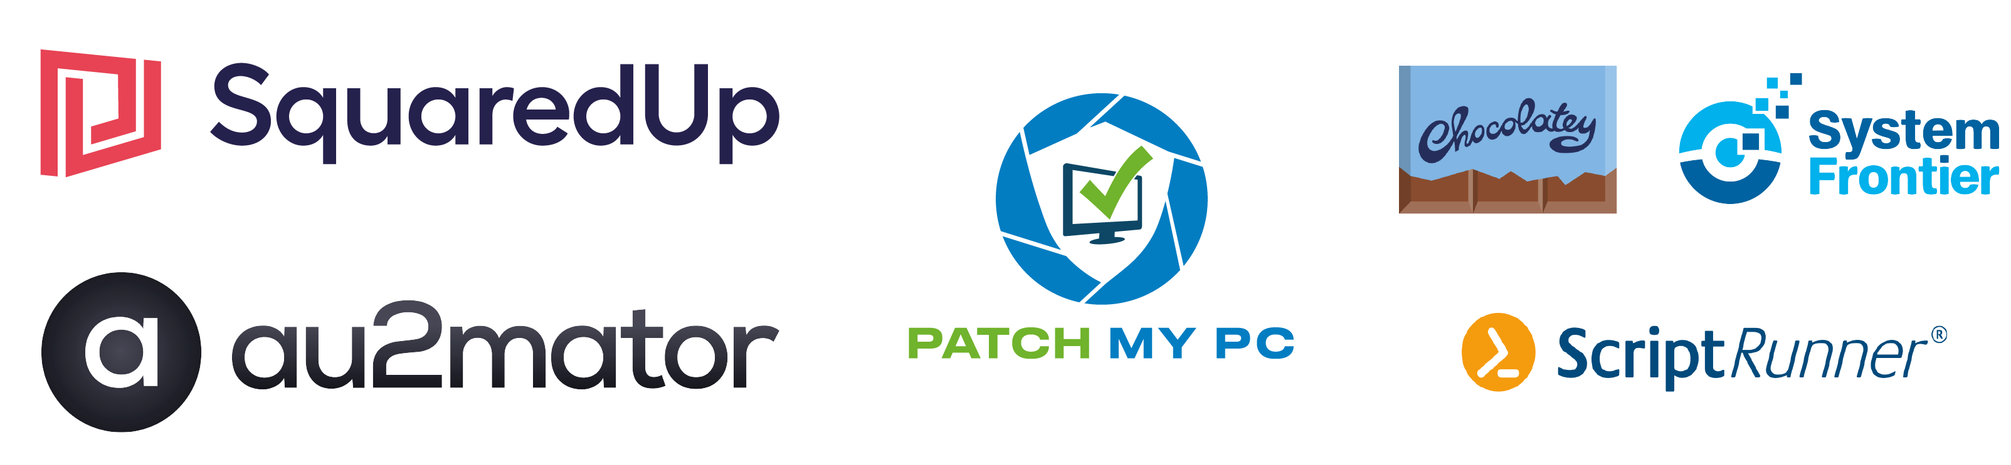
Many thanks to our sponsors:

Slide 3
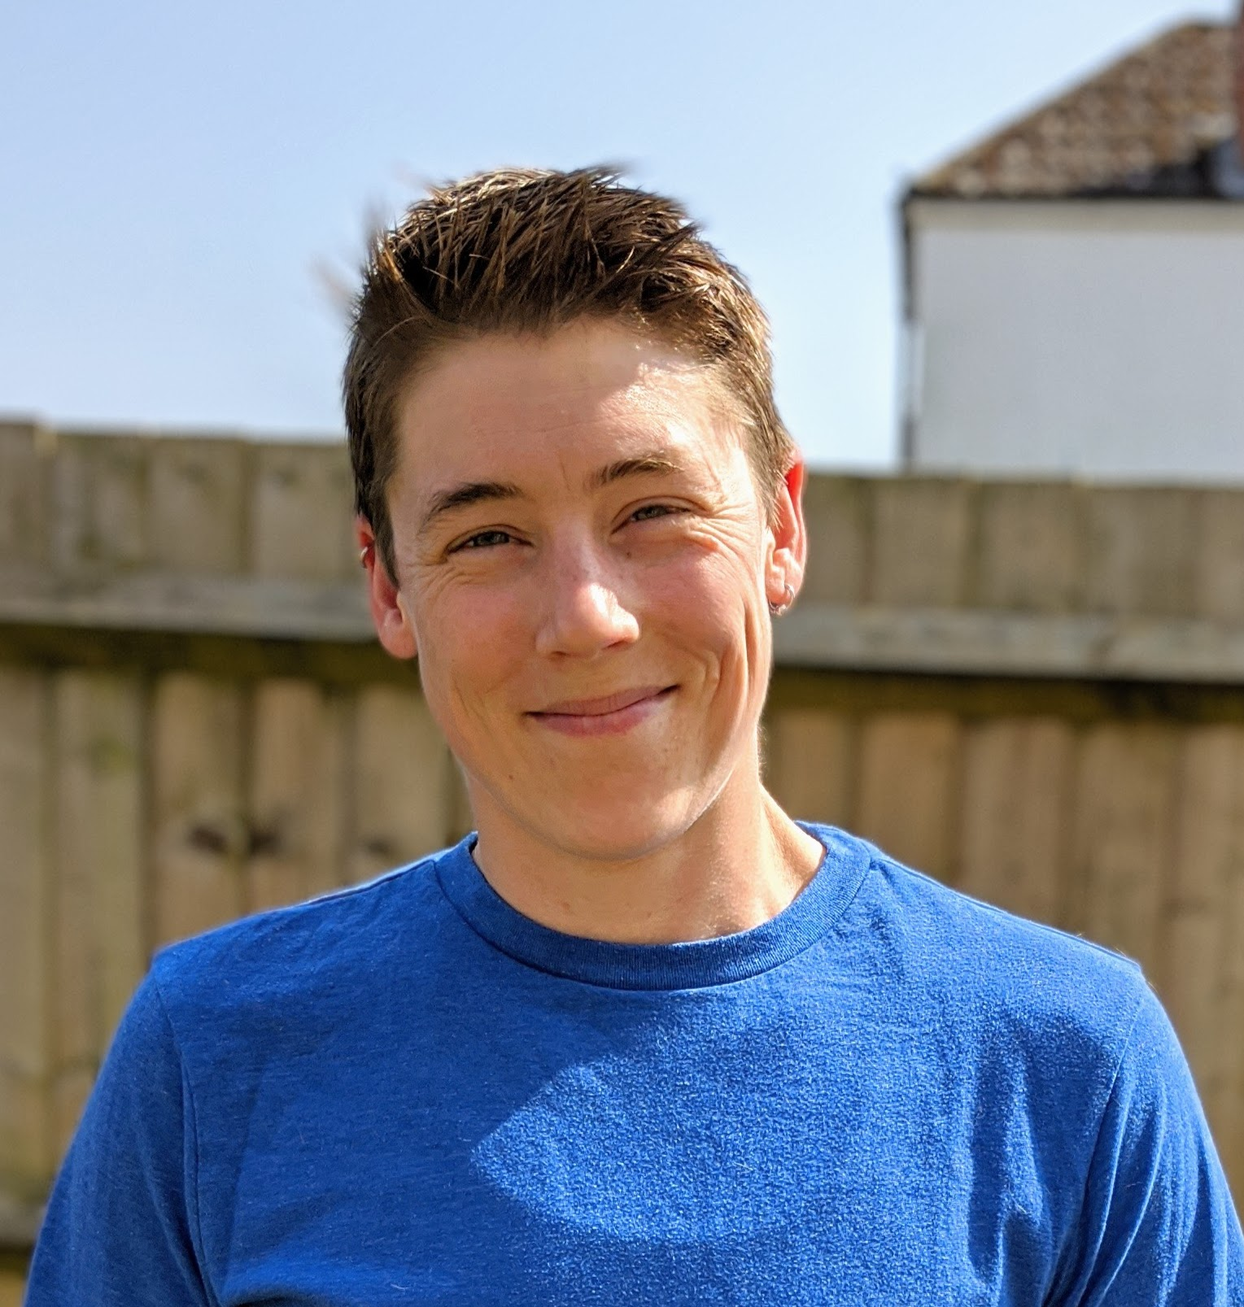

Jess Pomfret
She/Her
Passionate about
Automation
Proper Football
Fitness
Database Platform Architect Data Masterminds
beard.media/book dbatools dbachecks PowerShell & Data Community
/jpomfret
@jpomfret
jesspomfret.com

Slide 4
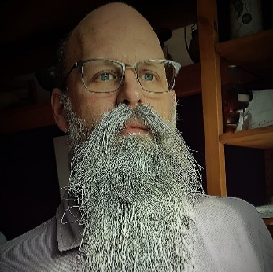
Rob Sewell
He/Him
Bearded Consultant, Automator,
Trainer
Consultant Sewells Consulting Ltd
beard.media/book dbachecks PowerShell & Data Community
/robsewellsqldba
@sqldbawithbeard
blog.robsewell.com

Slide 5
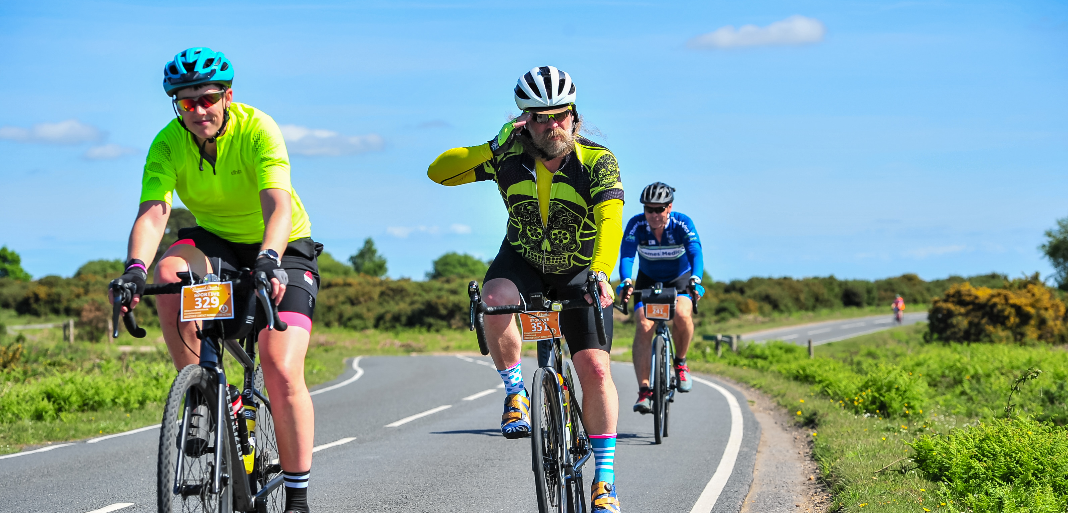

Slide 6
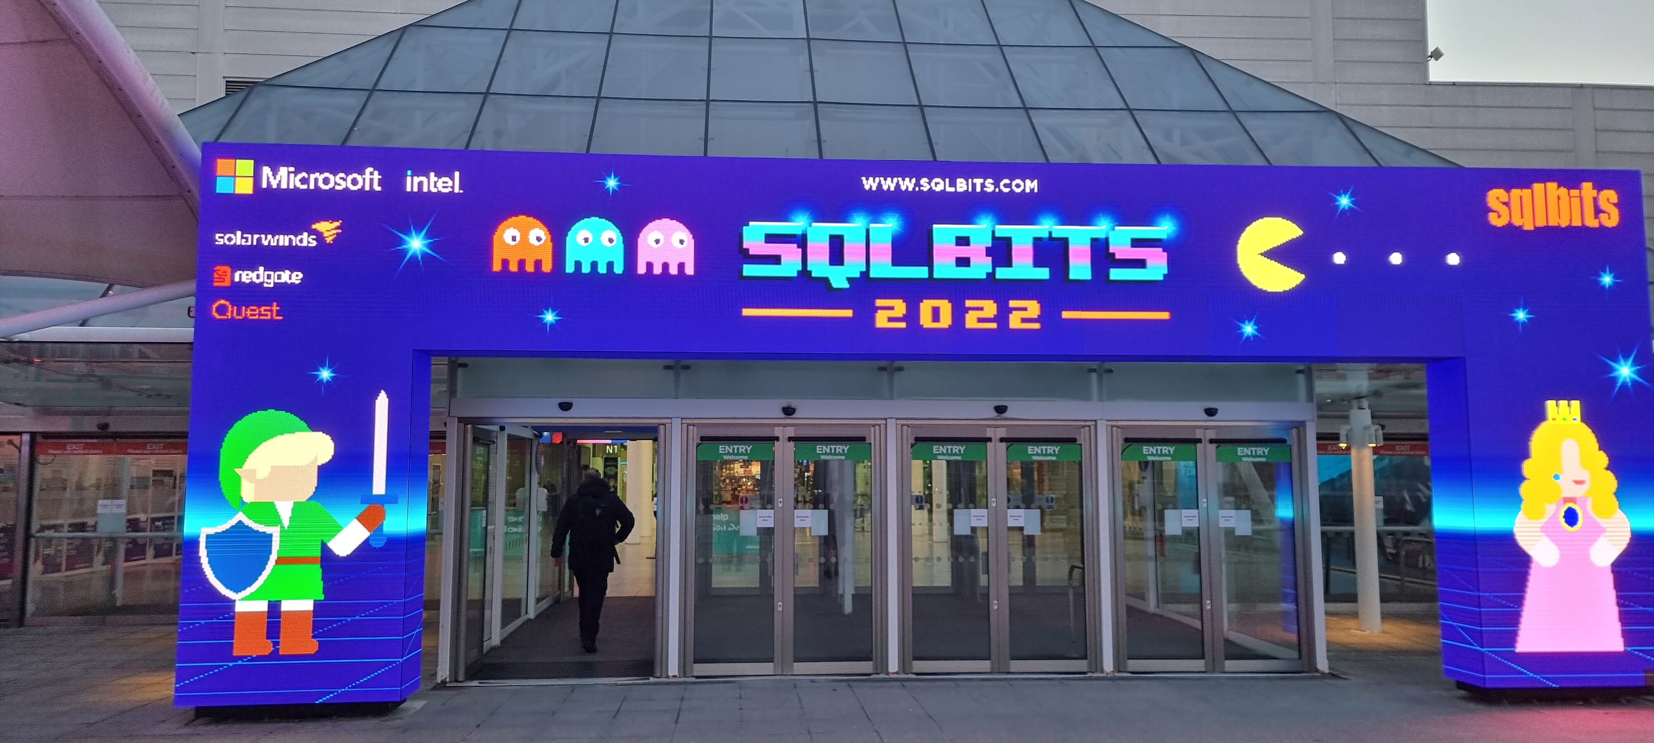
SQLBits 2022
Hybrid Event with in-person at the Excel Centre London

Slide 7
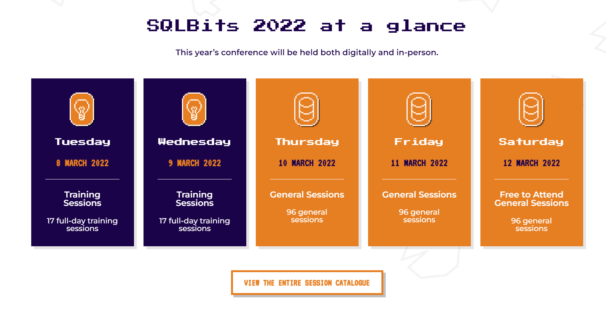
SQLBits 2022
Largest European Microsoft Data Platform Conference

Slide 8
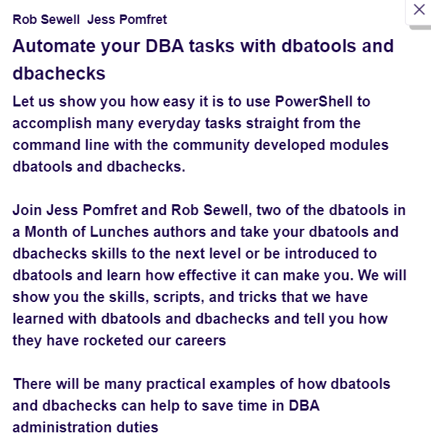
SQLBits 2022
A whole day training on dbatools ☺
70 remote attendees
30 in-person attendees

Slide 9

SQLBits 2022
A whole day training on dbatools ☺
1 remote presenter
1 in-person presenter

Slide 10
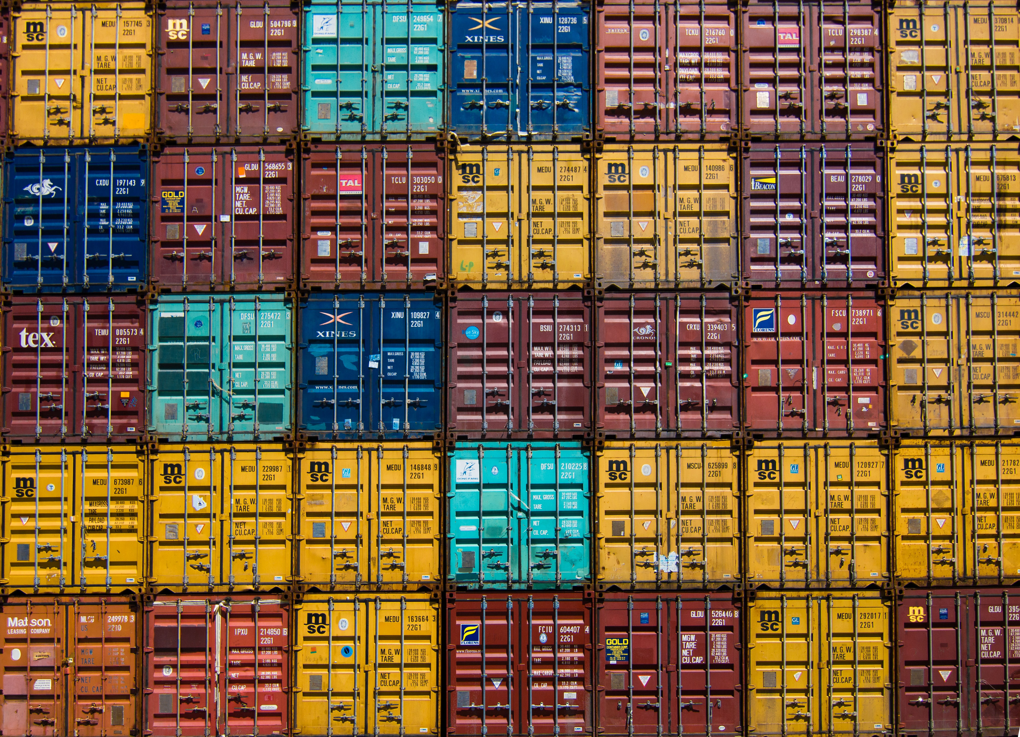
Identical
We wanted everyone to be able to have the same experience, to be able to follow along and practice after the training
Photo by Jan Antonin Kolar on Unsplash

Slide 11
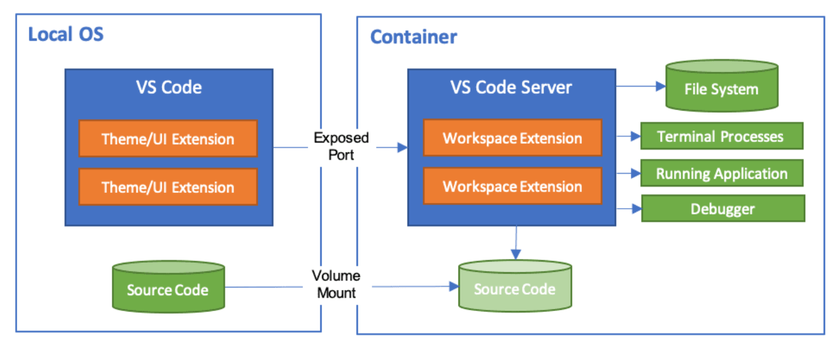
Dev Container
code.visualstudio.com/docs/remote/containers

Slide 12
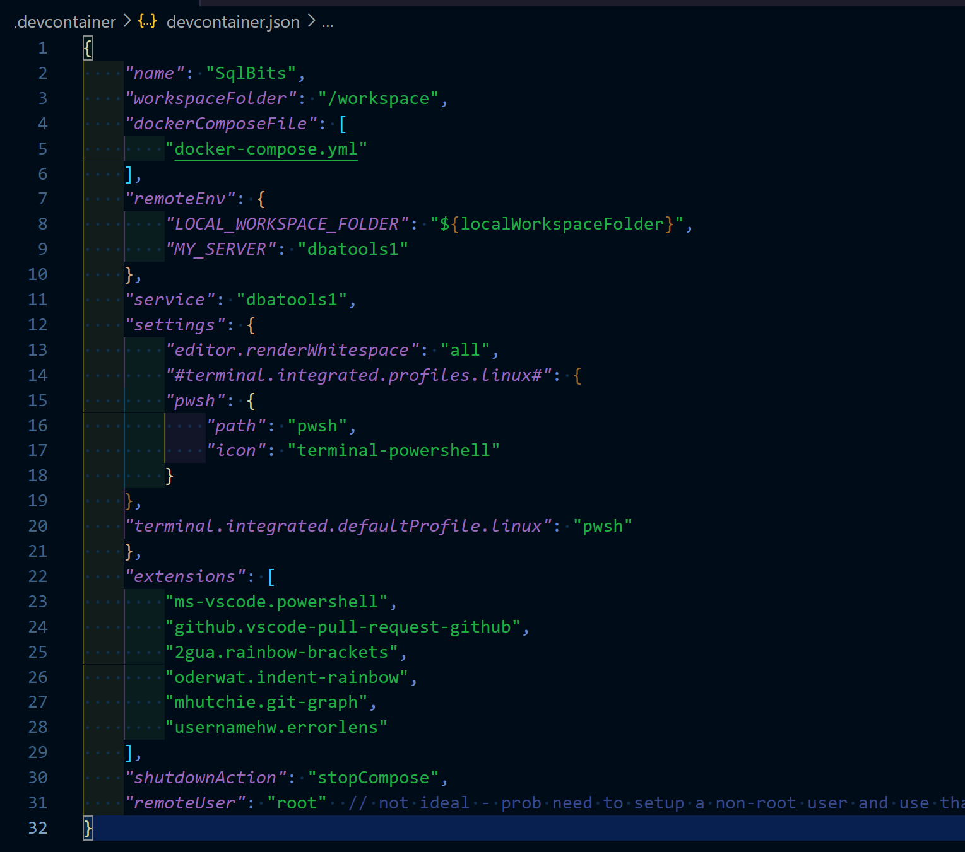
devcontainer.json
Notes:
Just add a devcontainer.json and set it up how you want your environment to be

Slide 13

We need to Copy
Need more than one container
Photo by Jan Antonin Kolar on Unsplash

Slide 14
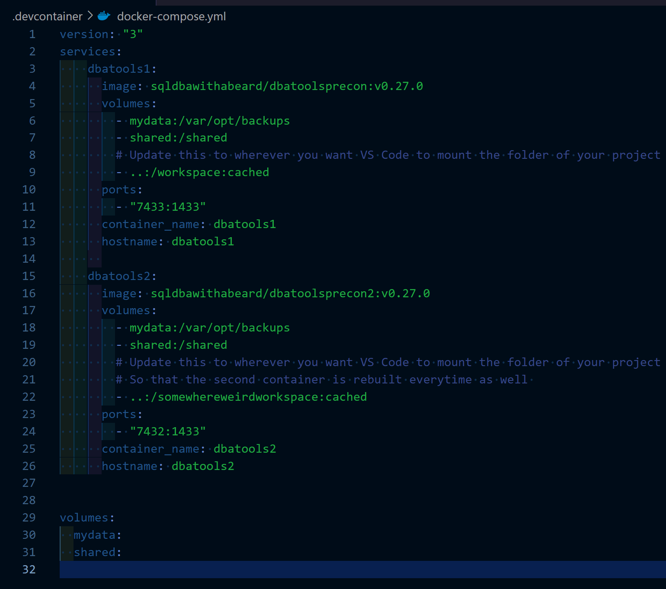
docker-compose.yaml
Notes:
So we can just add a docker compose with two containers

Slide 15
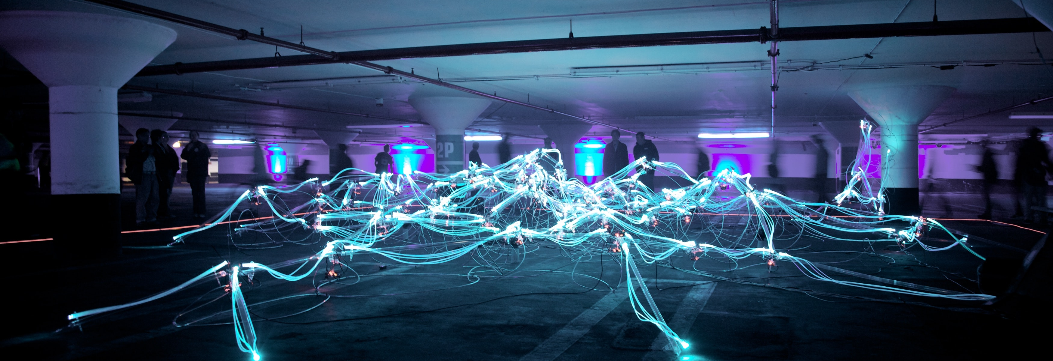
We don’t want to manually update
Photo by Marius Masalar on Unsplash
Notes:
So we can just add a docker compose with two containers

Slide 16
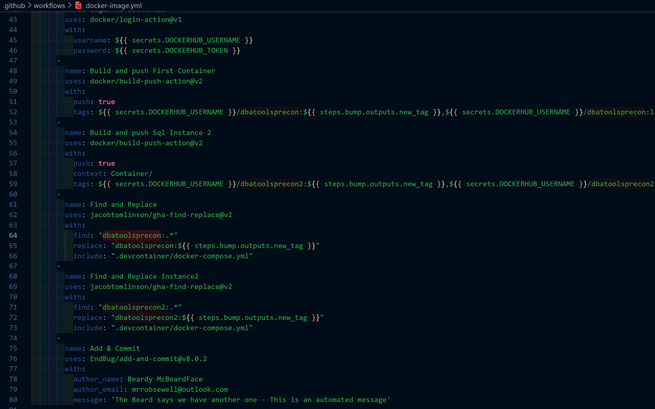
GitHub workflow
Notes:
So we can just add a docker compose with two containers

Slide 17
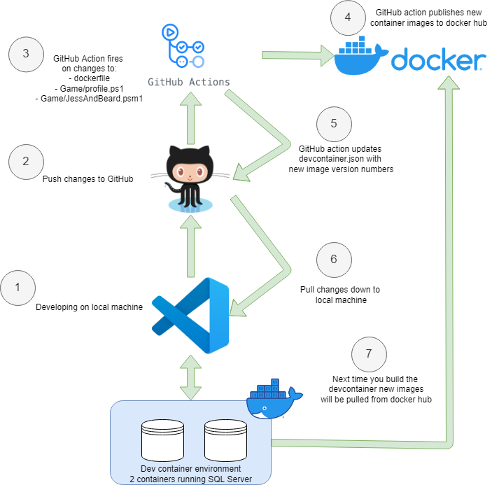
Development Workflow

Slide 18
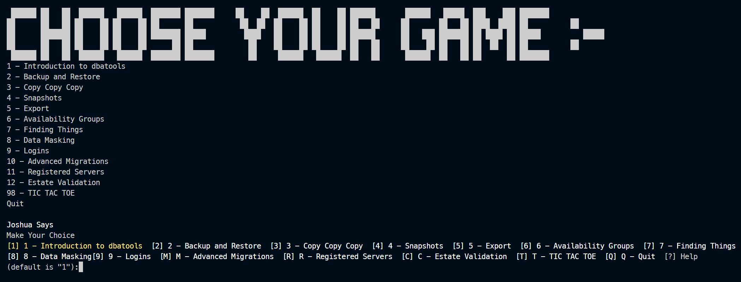
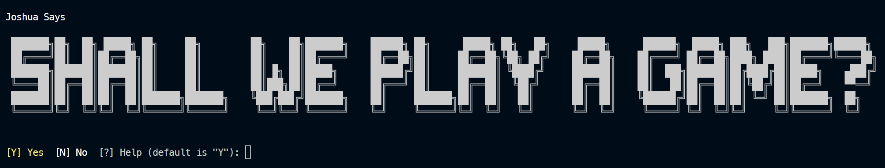
We want to have a bit of Fun too!
Notes:
So we can just add a docker compose with two containers

Slide 19
We want to have a bit of Fun too!
Notes:
So we can just add a docker compose with two containers

Slide 20
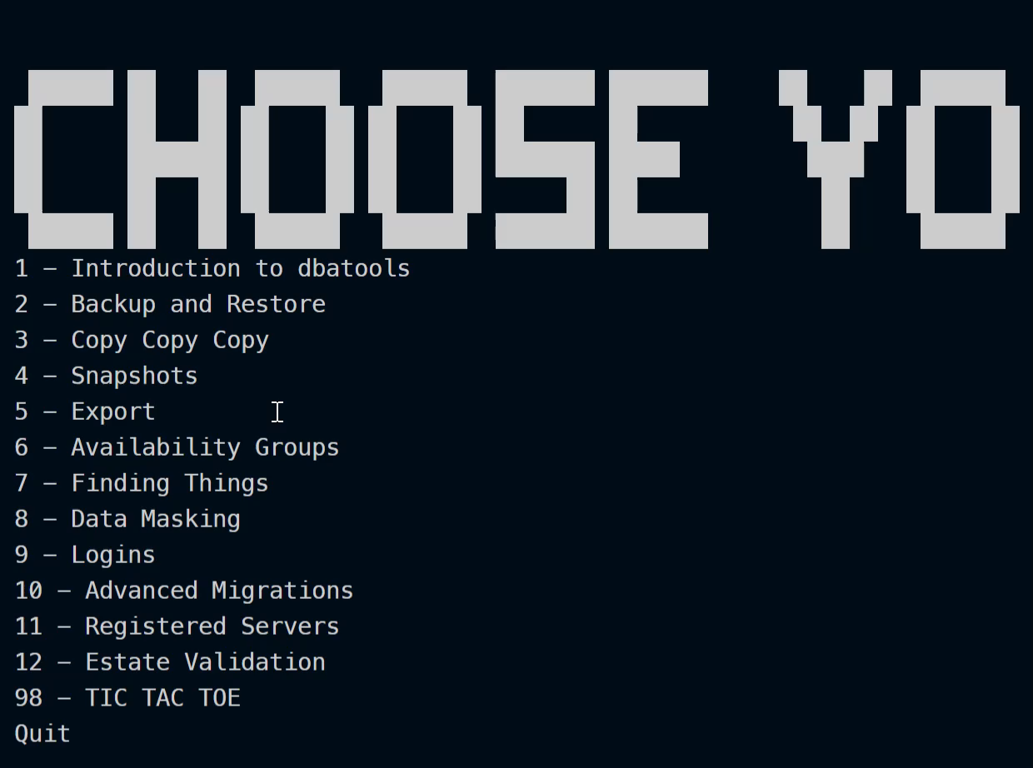
Notes:
So we can just add a docker compose with two containers

Slide 21
Demos
We prefer lots of Demos!
Notes:
Bitsdbatools/Notes.md at main · SQLDBAWithABeard/Bitsdbatools (github.com) – links to GitHub history

Slide 22
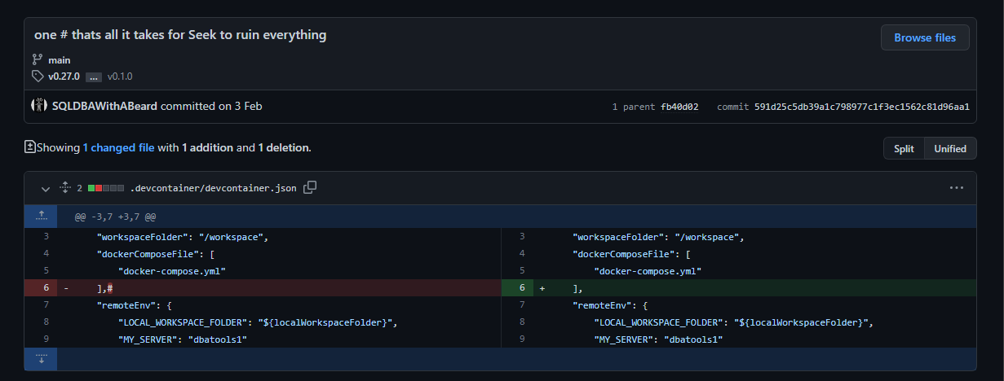
Demos
We prefer lots of Demos!
…a wander through the learnings captured in git
Notes:
Don’t know if you want to add an image to the demo slide but this is prob my fave commit (otherwise can remove this slide and use the previous one)
Bitsdbatools/Notes.md at main · SQLDBAWithABeard/Bitsdbatools (github.com) – links to GitHub history

Slide 23
Demos
Open in dev container – show backup restore chaos
From a single container to needing two
Show docker build process – install pwsh – modules copy profile
Why what does profile do?
Github action – bump the version of container and docker compose
Profile – code into container
Docker ps –a in windows terminal
Then rebuild and – created date doesn’t change
Find some funny commits
No thermonuclear war
Seek
Found bugs
Consistency on credential parameter name on multiple commands · Issue #8193 · dataplat/dbatools (github.com)
Notes:
GitHub history links
https://github.com/SQLDBAWithABeard/Bitsdbatools/blob/main/Notes.md

Slide 24



